Slide 1

Sabaiko Blood Bank
A Web-Based Blood Donation Management Platform for Nepal
Presented by: Dinesh Poudel
BCA 4th Semester, Nepathya College (affiliated to Tribhuvan University.

Slide 2
Agenda
01
02
Project Overview & Motivation
Problem Statement & Objectives
03
04
System Features & Functionality
Technical Architecture & Database Design
05
06
Security & User Workflows
Current Progress & Demo Highlights
07
Challenges & Future Plans

Slide 3

Introduction
A Lifeline for Nepal:
Sabaiko Blood Bank
Blood donation is a critical pillar of healthcare, essential for emergencies, complex surgeries, and ongoing treatments for chronic conditions. Yet, in Nepal, the existing systems are fragmented and inefficient, leading to critical delays.
Sabaiko Blood Bank proposes a centralized web platform designed to seamlessly connect donors, recipients, and hospitals, ensuring timely and efficient blood distribution.

Slide 4

Project Overview & Motivation
What is Sabaiko Blood Bank?
A web-based platform connecting verified blood donors with receivers (hospitals, blood banks) in Nepal.
Why this system?
Addresses critical blood shortage in Nepal.
Centralizes and verifies donor information.
Personal motivation to save lives through technology.
Real-World Impact
Streamlines donation, reduces search time, and builds trust through verification.

Slide 5

Problem Statement: Current Challenges
No Centralized Database
Difficult to find available donors quickly.
Lack of Verification
Risk of fake profiles and fraud.
Geographic Barriers
Hard to locate nearby donors efficiently.
Manual Coordination
Delays in emergency situations.
Goal: Build a secure, role-based platform to solve these critical issues.

Slide 6

Primary Objectives
Centralized Donor Database
Quick Donor Search
Create a searchable database of verified donors.
Enable receivers to find donors by blood type and location.
Role-Based Access Control
Quick Receiver Search
Implement secure access for different user roles.
Enable Donors to verify Receivers by searching their phone number.
Secondary Objectives:
Nepal-specific address system for accurate location.
Responsive design for mobile accessibility.

Slide 7
System Features & Functionality
Role-Based System
User Registration & Verification
Donor Search (for Receivers)
Receiver Search (for Donors)
Admin, Donor, Receiver roles with distinct permissions.
Filter by blood group and Nepal-specific location (Province, District, Palika, Ward).
Search by phone number to verify is the Receiver is verified or not.
All users start as PENDING; Admin approves/rejects to APPROVED status.

Slide 8
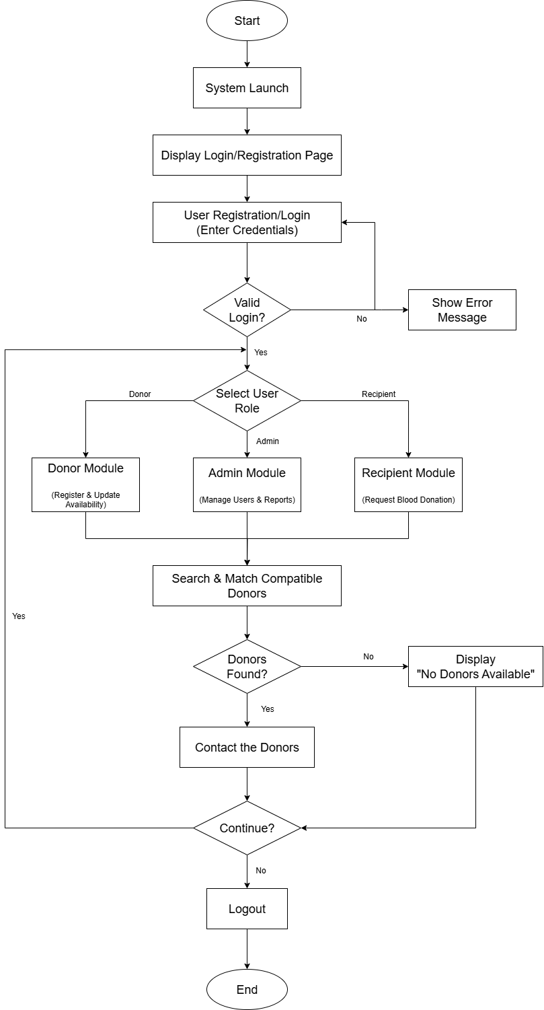
Flow Chart:

Slide 9
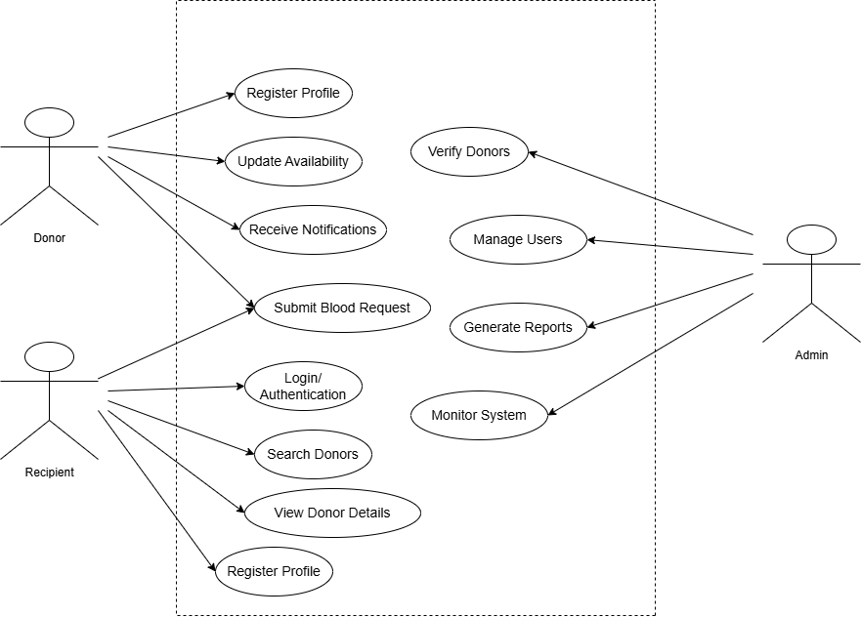
Use Case Diagram:

Slide 10
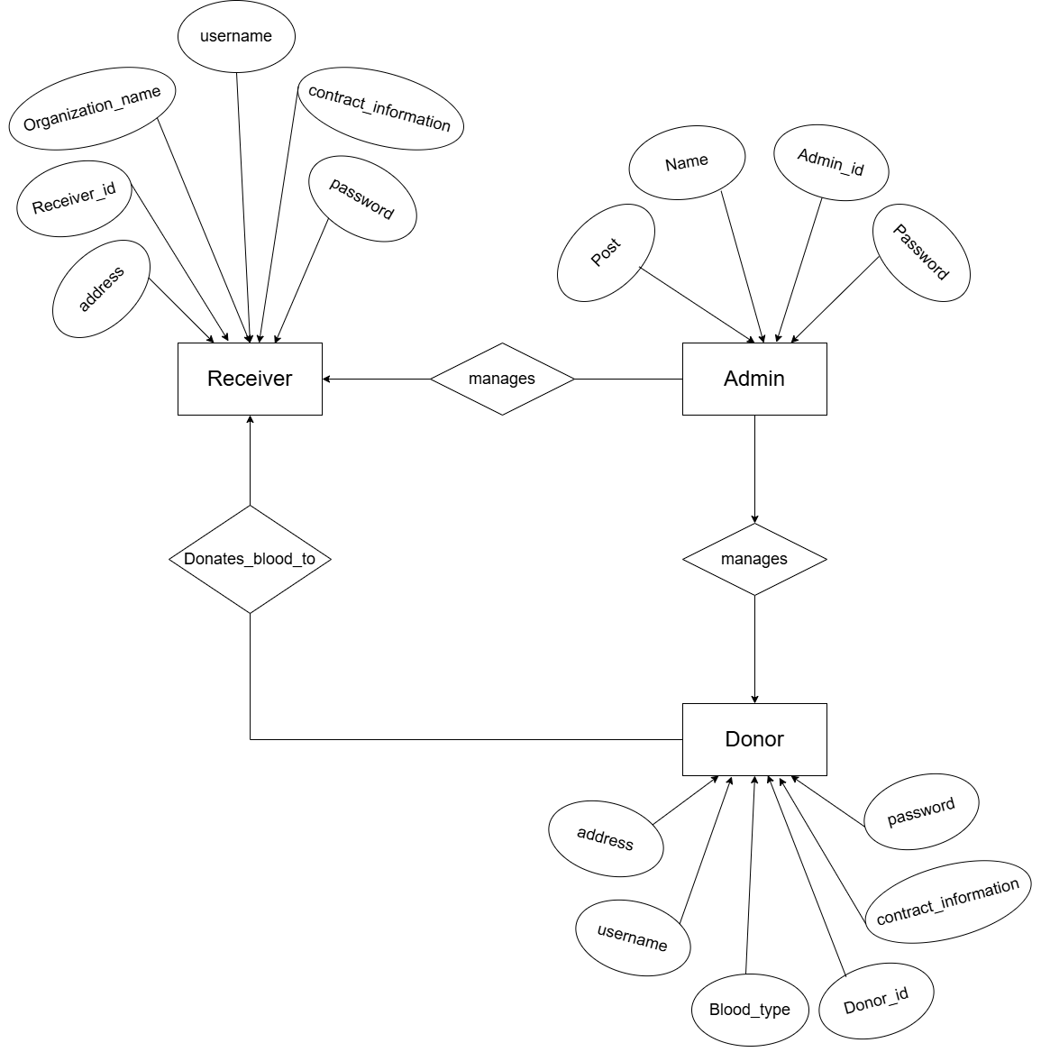
ER Diagram:

Slide 11
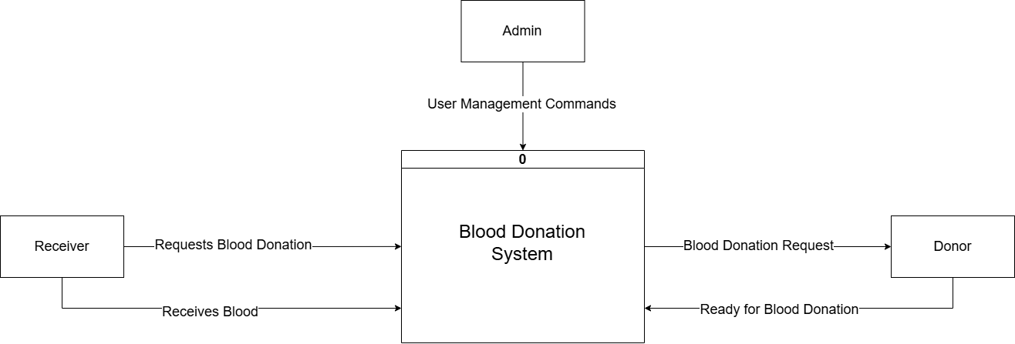
Context Level DFD:

Slide 12
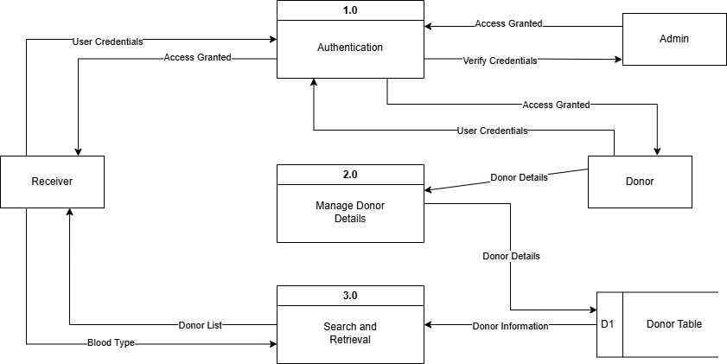
Level-1 DFD:

Slide 13
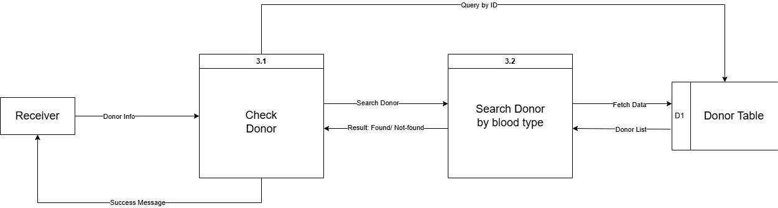
Level-2 DFD:

Slide 14
Technical Architecture
Backend
Spring Boot
3.3.5
Language
Java
21
Database
PostgreSQL
12+
Security
Spring Security
6.x
CSS Framework
Tailwind CSS + Bootstrap 5
-
Architecture Pattern: 3-Layer (Presentation → Business Logic → Data Access).

Slide 15

Security Implementation & User Workflows
Multi-Layer Security:
User Workflows:
Authentication: Form login with BCrypt encryption.
Admin: Approve/reject users, manage users, add stars, view stats.
Authorization: Role-based access (ADMIN, DONOR, RECEIVER).
Donor: Register, update profile, search Receivers.
Status Validation: Only APPROVED users can log in.
Receiver: Register, update profile, search Donors.
Admin approval required for all new users to prevent spam/fake accounts.

Slide 16
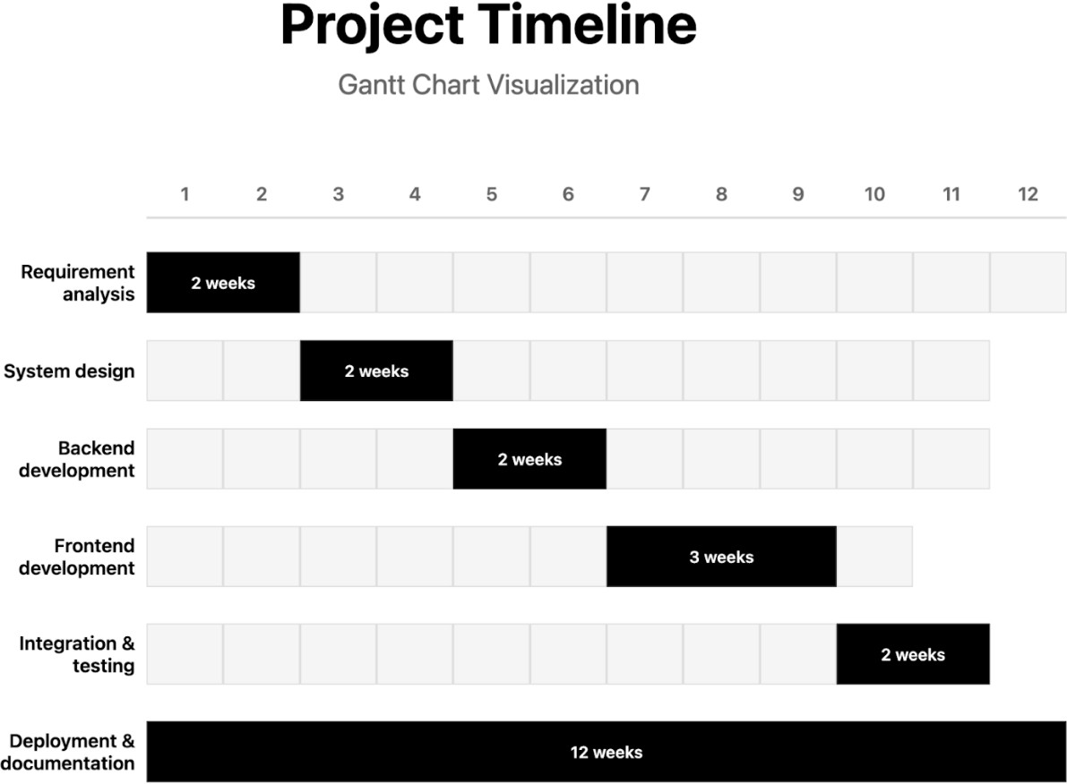

Slide 17
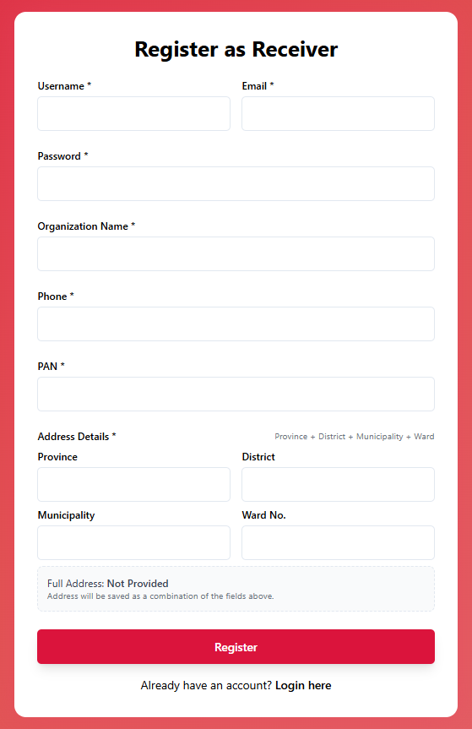
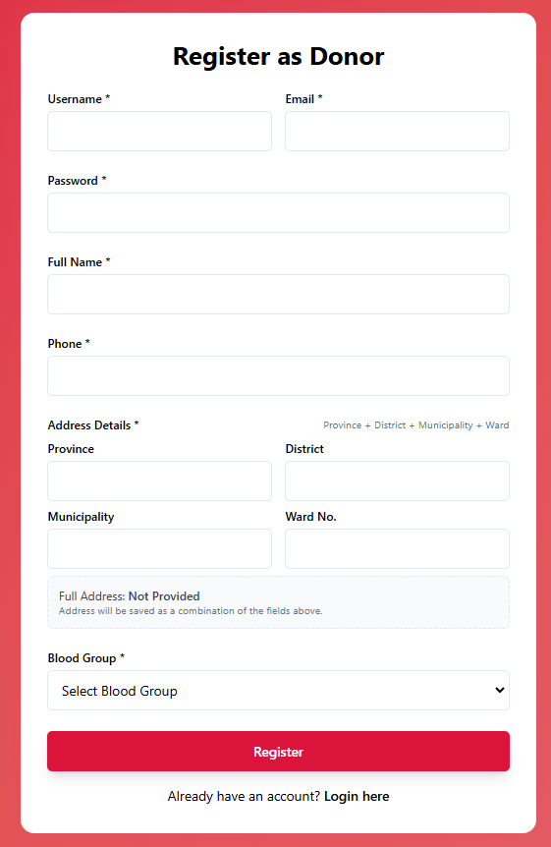
Register account
as Receiver
Or
as Donor

Slide 18
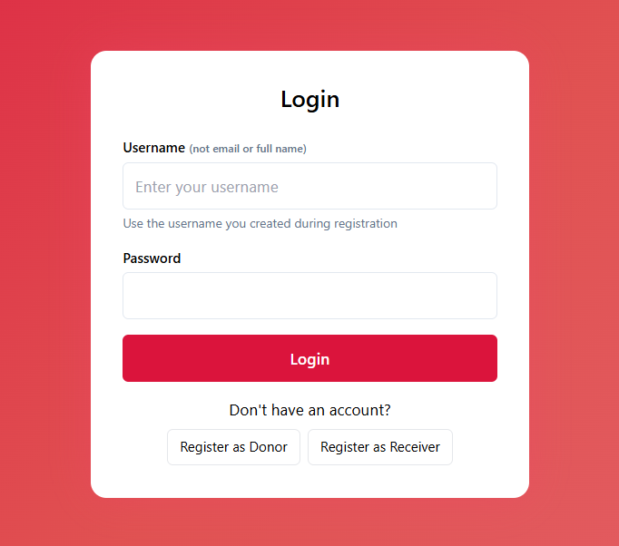
Login page:

Slide 19
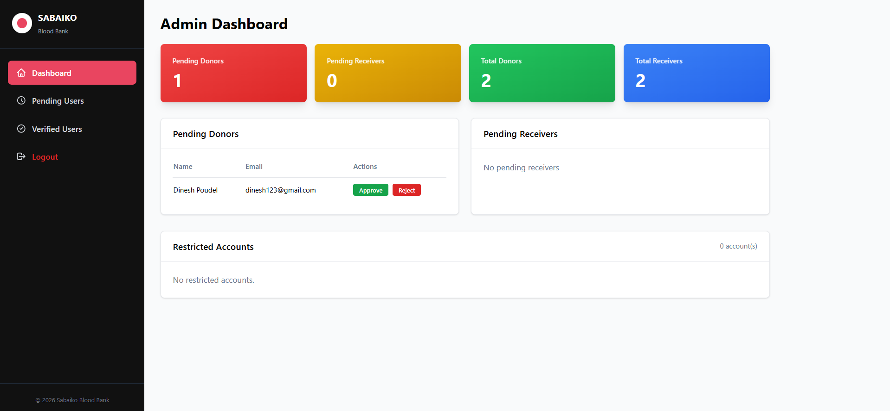
Admin Dashboard:

Slide 20
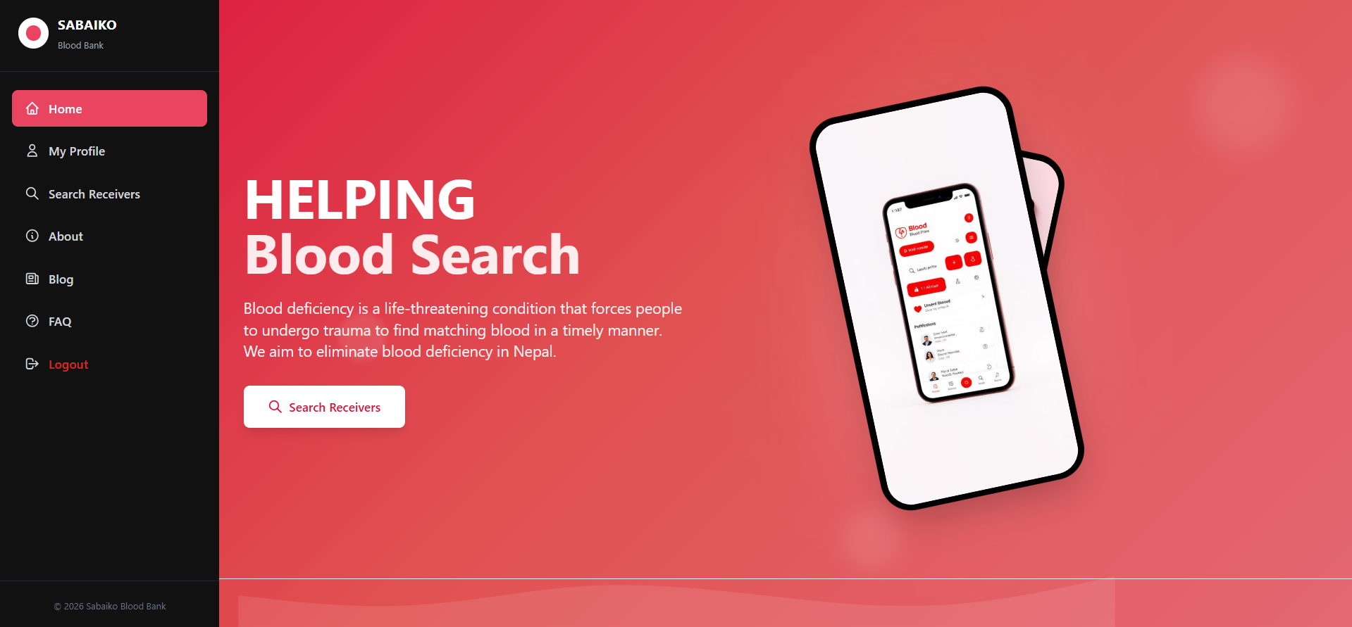
Receiver/Donor Home page:

Slide 21
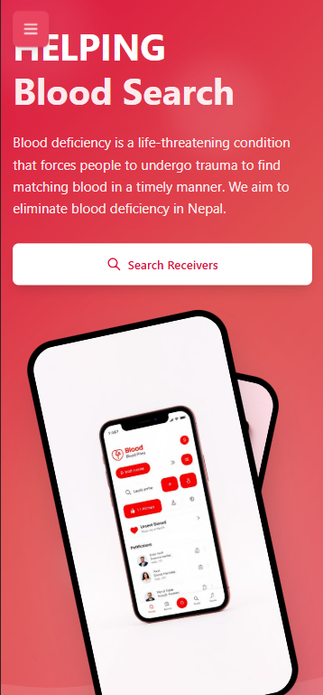
Mobile View:

Slide 22

Key Takeaways
Enhanced Efficiency
Automated processes and a centralized database streamline operations, making blood donation and distribution faster and more effective.
Improved Safety & Transparency
Digital tracking and real-time data monitoring ensure higher standards of blood safety and complete transparency for all stakeholders.
Greater Community Impact
By connecting donors and recipients more efficiently, Sabaiko Blood Bank will save countless lives and significantly strengthen Nepal's healthcare system.
Future Vision
Integration with NRCS central database via API.
Mobile applications (React Native) with push notifications.
SMS gateway integration using local providers (Ncell/NTC API).
AI-based prediction of blood demand during festivals/disasters.
Blockchain-based immutable donation history for credibility.

Slide 23

Thank You!

